Slide 1
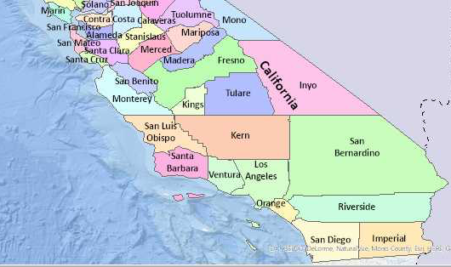
Valley Fever
Environmental
Austin, Le, Félix, Sanaa

Slide 2
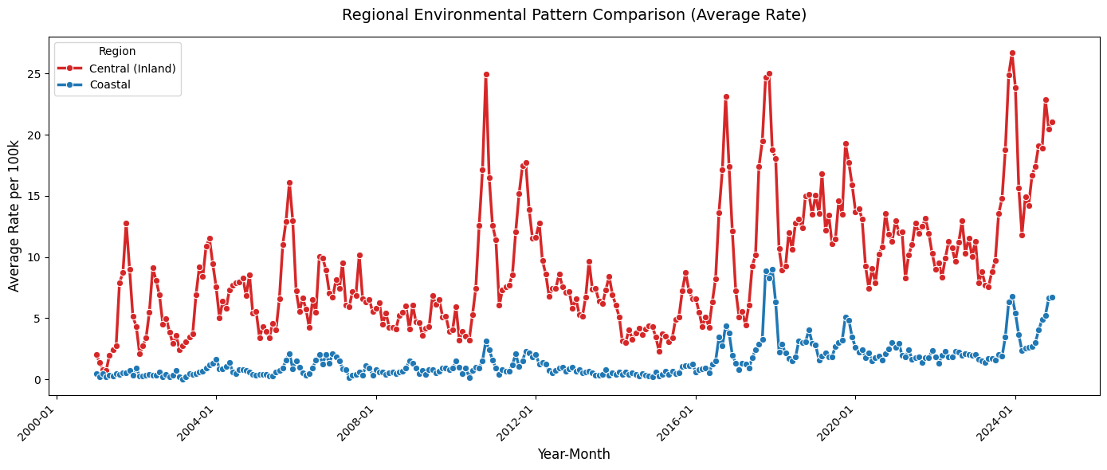

Slide 3
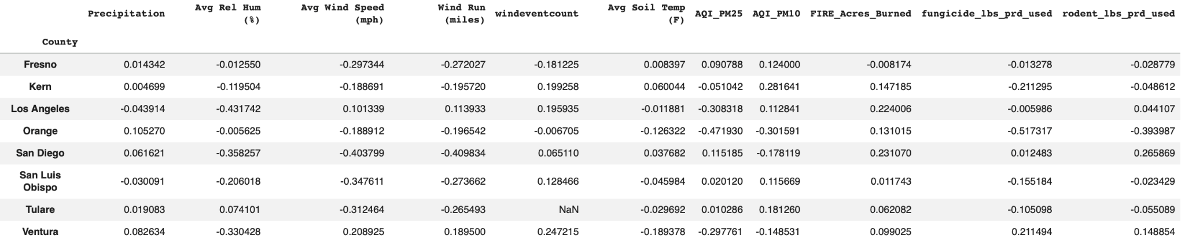
County Highest correlated Feature Corr_ Value(Asb)
Fresno Avg Wind Speed (mph) -0.297344
Kern AQI_PM10 0.28164 Los Angeles Avg Rel Hum (%) -0.431742
Orange Fungicide_lbs_prd_used -0.517317 San Diego Win Run (miles) -0.409834
San Luis Obispo Avg Wind Speed (mph) -0.347611
Tulare Avg Wind Speed (mph) -0.312464
Ventura Avg Rel Hum (%) -0.330428
These are the per county correlation values for the features vs. the valley fever rate 0.47

Slide 4
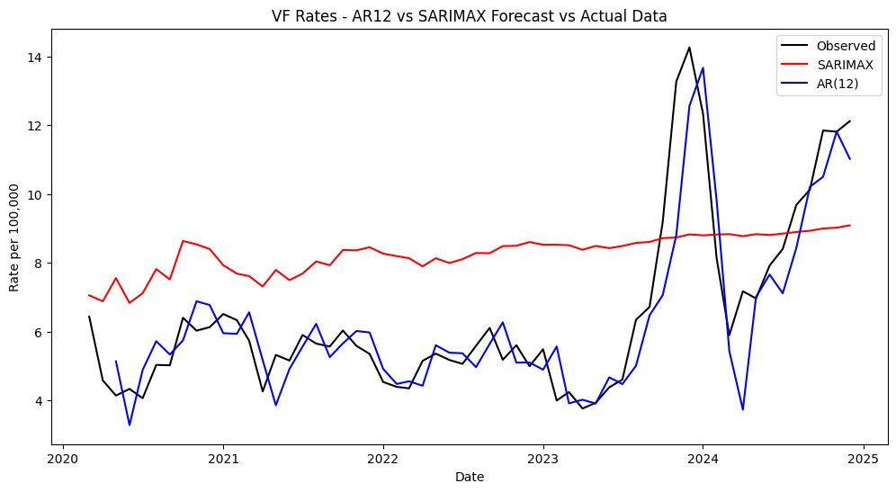
Notes:
SARIMAX: Seasonal Auto Regressive Integrated Moving Average w/ eXogenous factors

